Slide 1
University of Technical Education of Ho Chi Minh City
NETWORKING ESSENTIALS
Chapter 1.
Networking fundamentals
Huynh Nguyen Chinh
chinhhn@fit.hcmute.edu.vn
Notes:
1

Slide 2
Contents
Introduction
Computer network types
Network Topologies
Network security
Characteristics of a Network
Connection to the Internet

Slide 3
Introduction

Slide 4
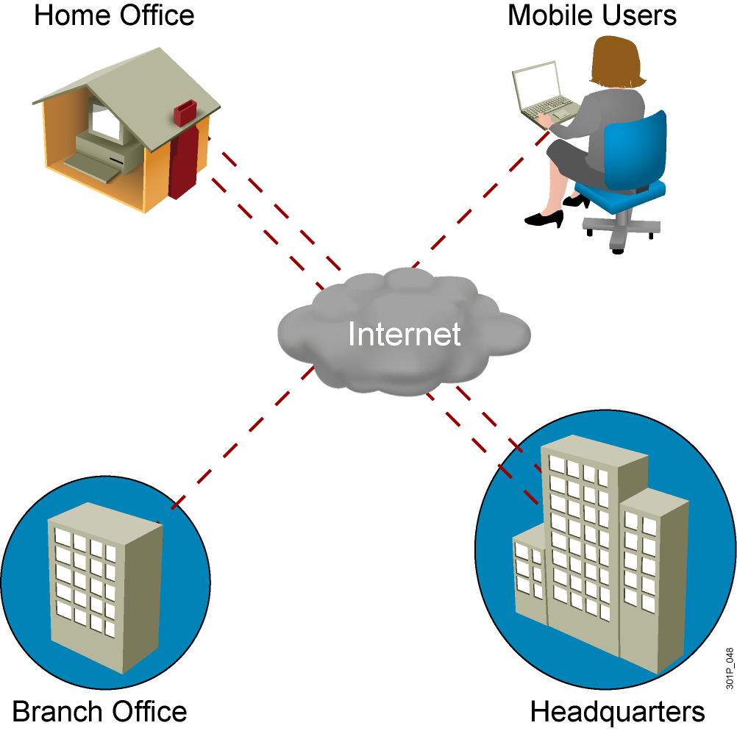
What is a network?

Slide 5
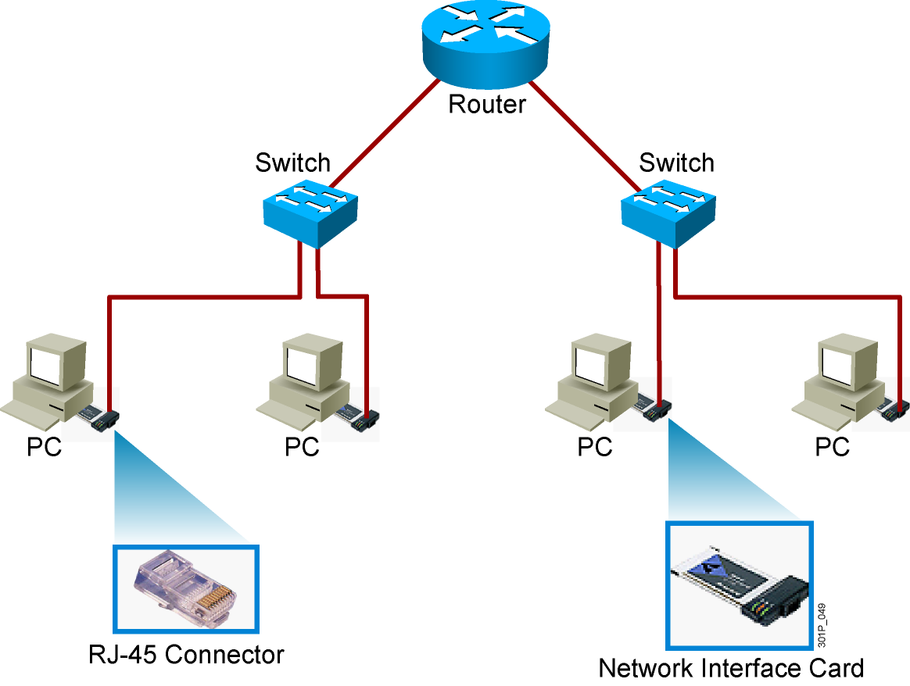
Common Physical Components of a Network

Slide 6
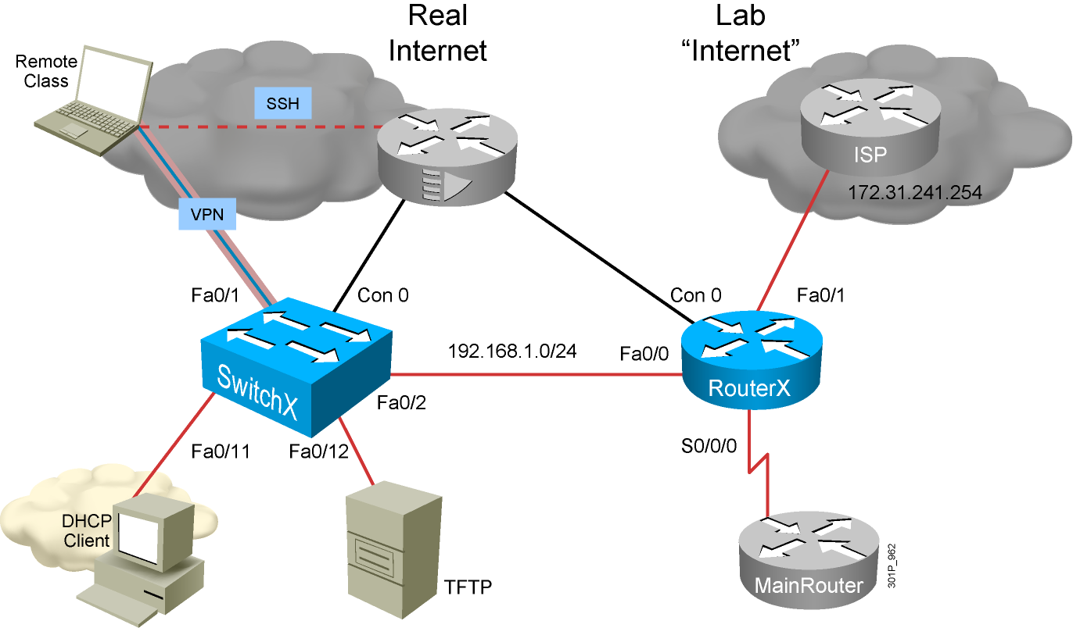
Interpreting a Network Diagram

Slide 7
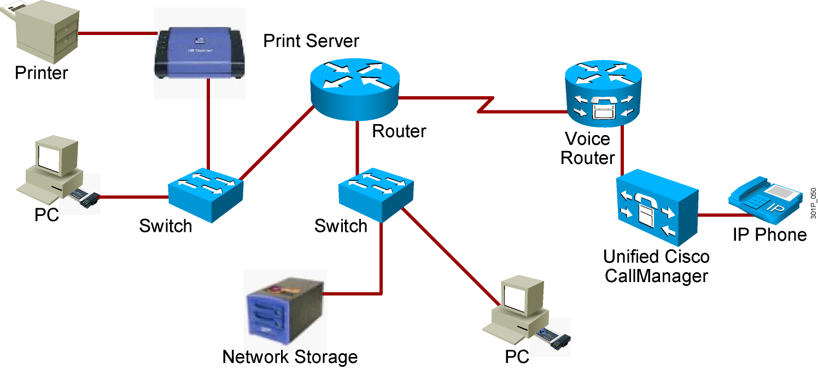

Resource-Sharing Functions and Benefits
Data and applications
Resources
Network storage
Backup devices

Slide 8
Network User Applications
E-mail (Outlook, POP3, Yahoo, and so on)
Web browser (IE, Firefox, and so on)
Instant messaging (Yahoo IM, Microsoft Messenger, and so on)
Collaboration (Whiteboard, Netmeeting, WebEx, and so on)
Databases (file servers)

Slide 9
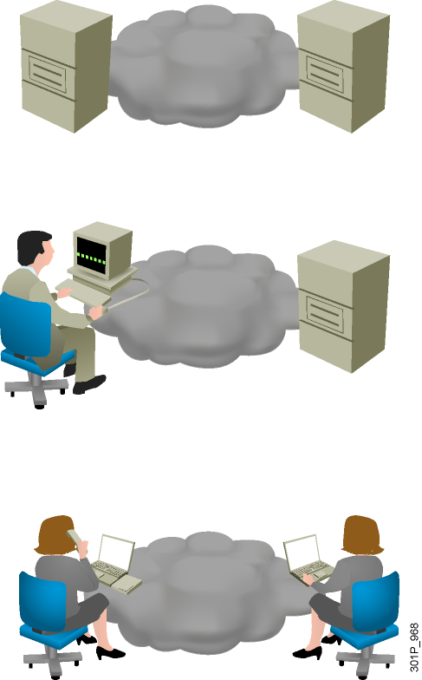
Impact of User Applications on the Network
Batch applications
FTP, TFTP, inventory updates
No direct human interaction
Bandwidth important, but not critical
Interactive applications
Inventory inquiries, database updates.
Human-to-machine interaction.
Because a human is waiting for a response, response time is important but not critical, unless the wait becomes excessive.
Real-time applications
VoIP, video
Human-to-human interaction
End-to-end latency critical

Slide 10
Computer network types

Slide 11
Local-area networks (LANs)
Operate within in a limited geographic area
Allow multi-access to high-bandwidth media
Provide full-time connectivity to local services
Connect physically adjacent device
Control the network privately under local administration
Lan topologies: Ethernet, Token Ring, FDDI, …

Slide 12
Wide-area networks (WANs)
Operate over a large geographically separated areas
Allow users to have real-time communication capabilities with other users
Provide full-time remote resources connected to local services
Provide e-mail, World Wide Web, File transfer, and e-commerce services
Some common WAN topogolies are: modem, ISDN, xDSL, Frame Relay,…

Slide 13
Metropolitan-area networks (MANs)
A MAN is a network that spans a metropolitan area such as a city or suburban area
MAN topologies: ATM, GE, 10 GE,…

Slide 14
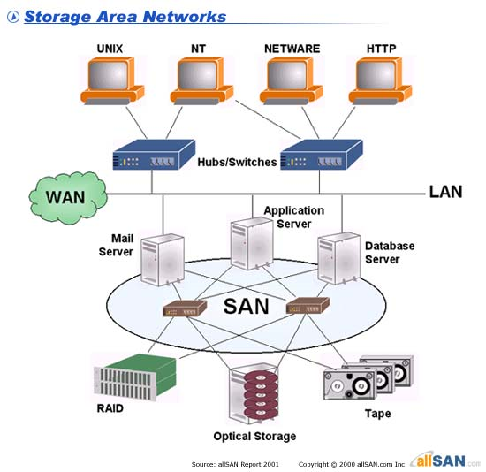
Storage-area networks (SANs)

Slide 15
Internet networks
Internet

Slide 16
Characteristics of a Network

Slide 17
Characteristics of a Network
Speed
Cost
Security
Availability
Scalability
Reliability
Topology

Slide 18
Network topologies

Slide 19
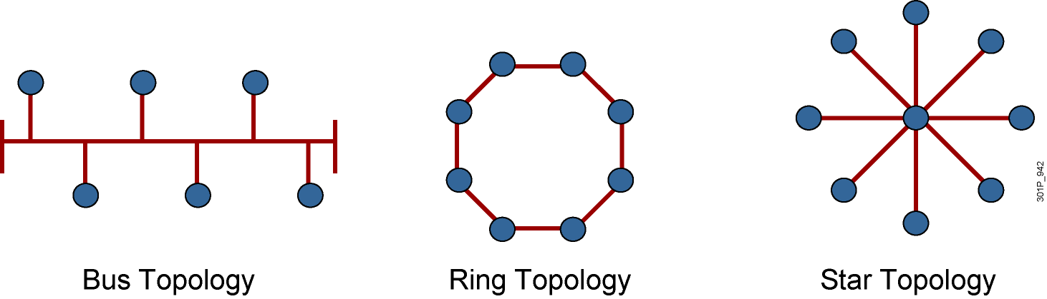
Physical Topology Categories

Slide 20
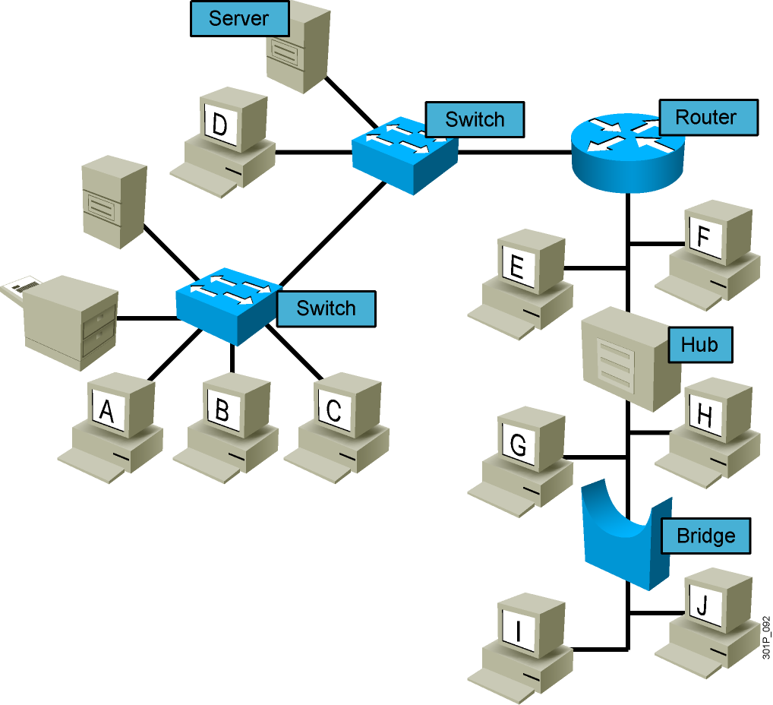
Logical Topologies
Notes:
Lesson Aim
<Enter lesson aim here.>

Slide 21
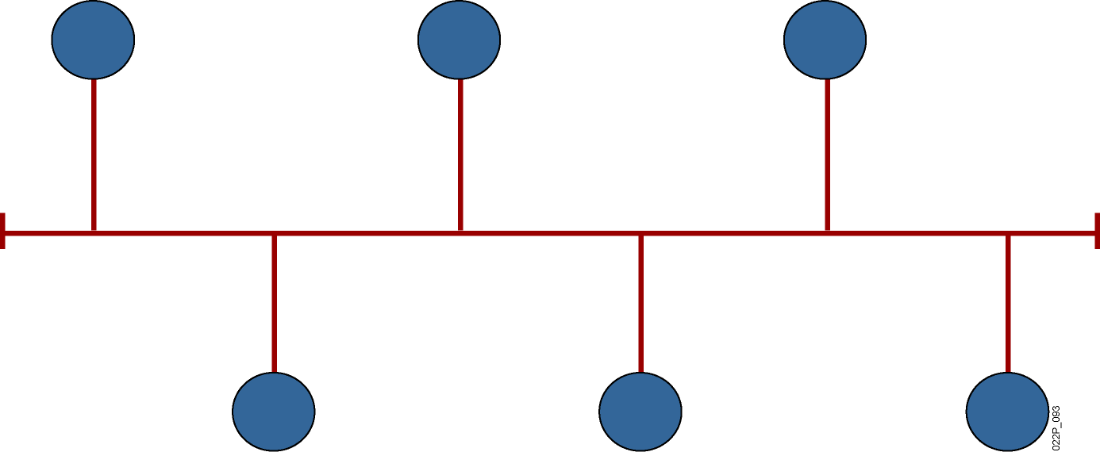
Bus Topology
All devices receive the signal.
Notes:
Lesson Aim
<Enter lesson aim here.>

Slide 22
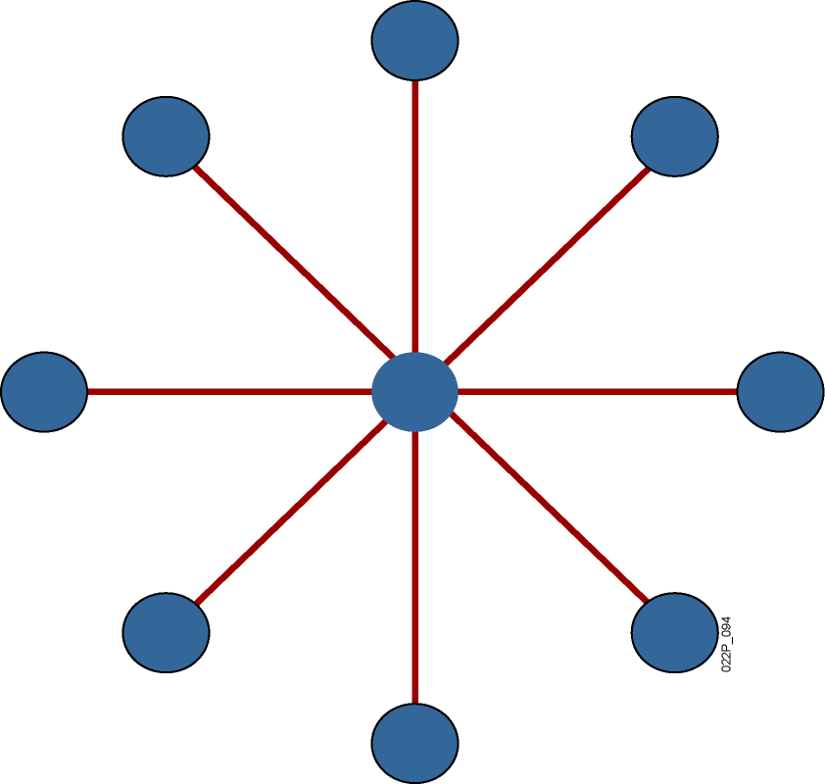
Star Topology
Transmission through a central point.
Single point of failure.
Notes:
Lesson Aim
<Enter lesson aim here.>

Slide 23
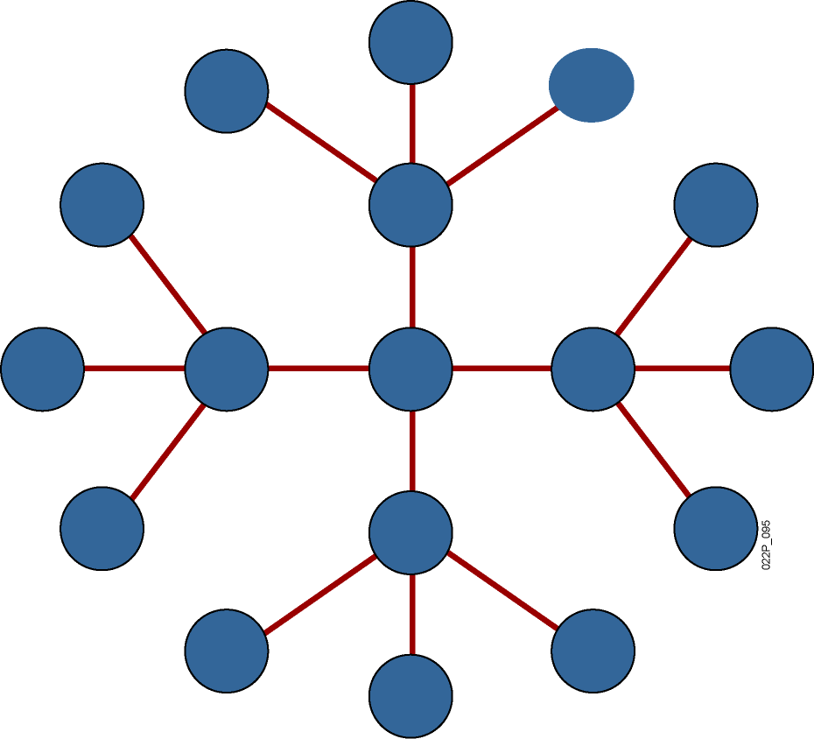
Extended-Star Topology
More resilient than star topology.
Notes:
Lesson Aim
<Enter lesson aim here.>

Slide 24
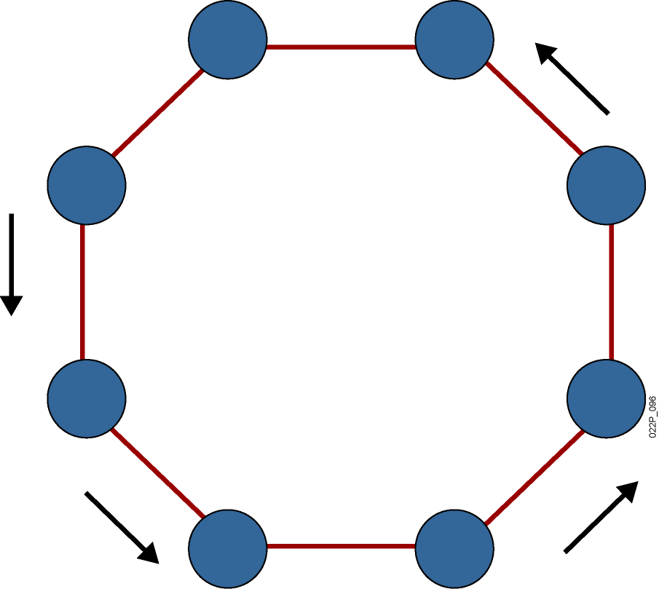
Ring Topology
Signals travel around ring.
Single point of failure.
Notes:
Lesson Aim
<Enter lesson aim here.>

Slide 25
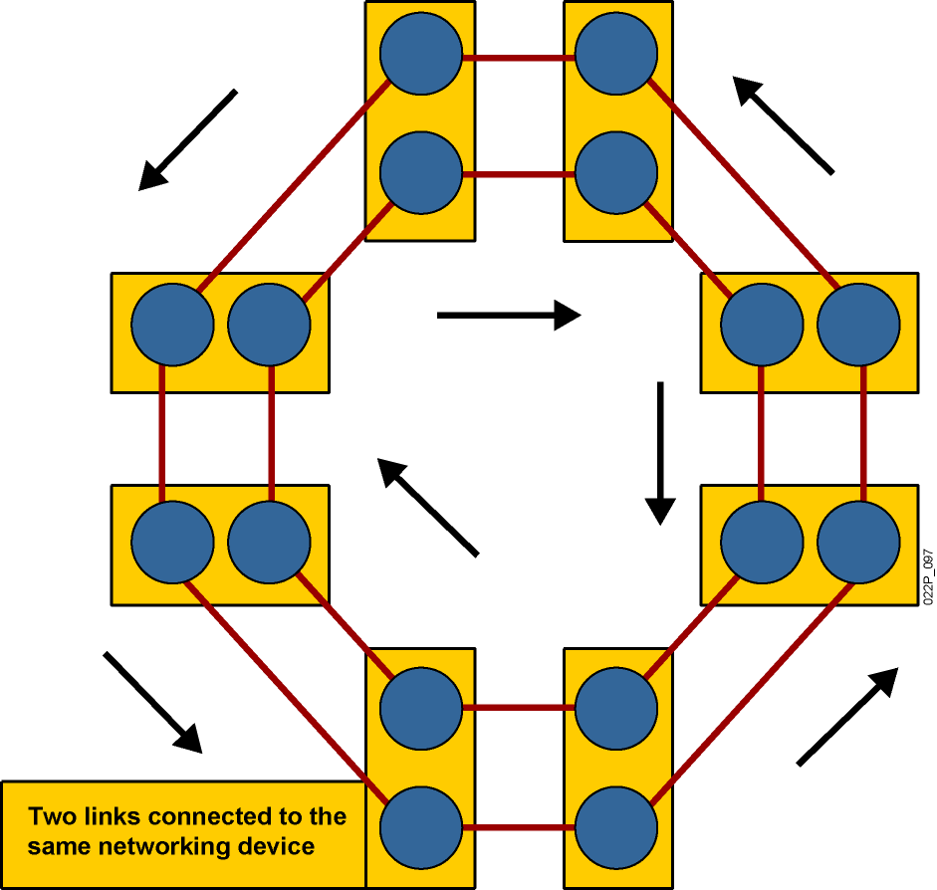
Dual-Ring Topology
Signals travel in opposite directions.
More resilient than single ring.
Notes:
Lesson Aim
<Enter lesson aim here.>

Slide 26
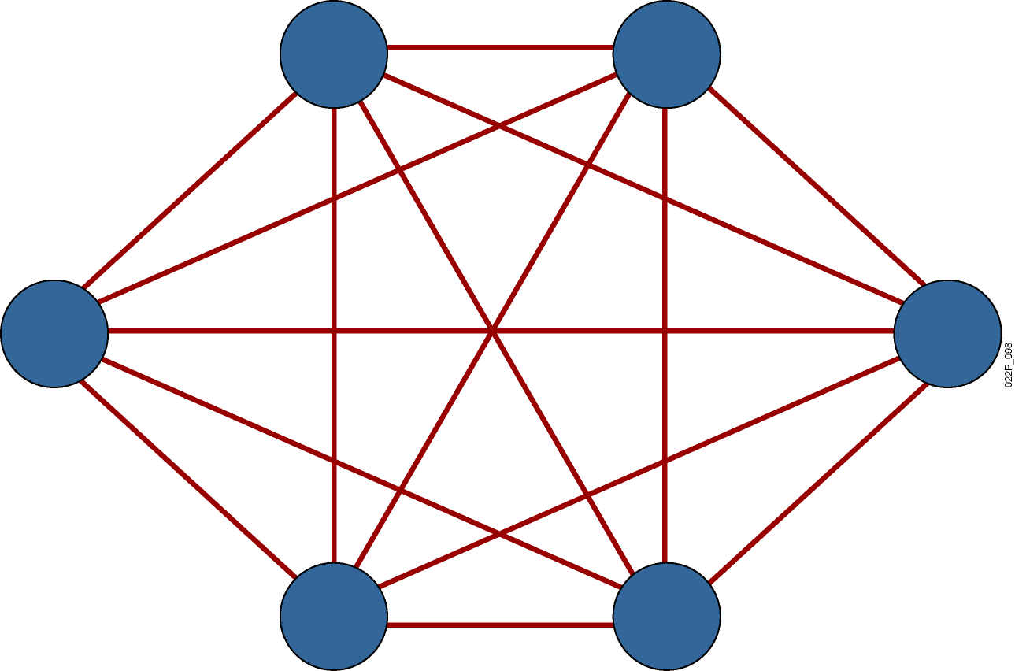
Full-Mesh Topology
Highly fault-tolerant
Expensive to implement
Notes:
Lesson Aim
<Enter lesson aim here.>

Slide 27
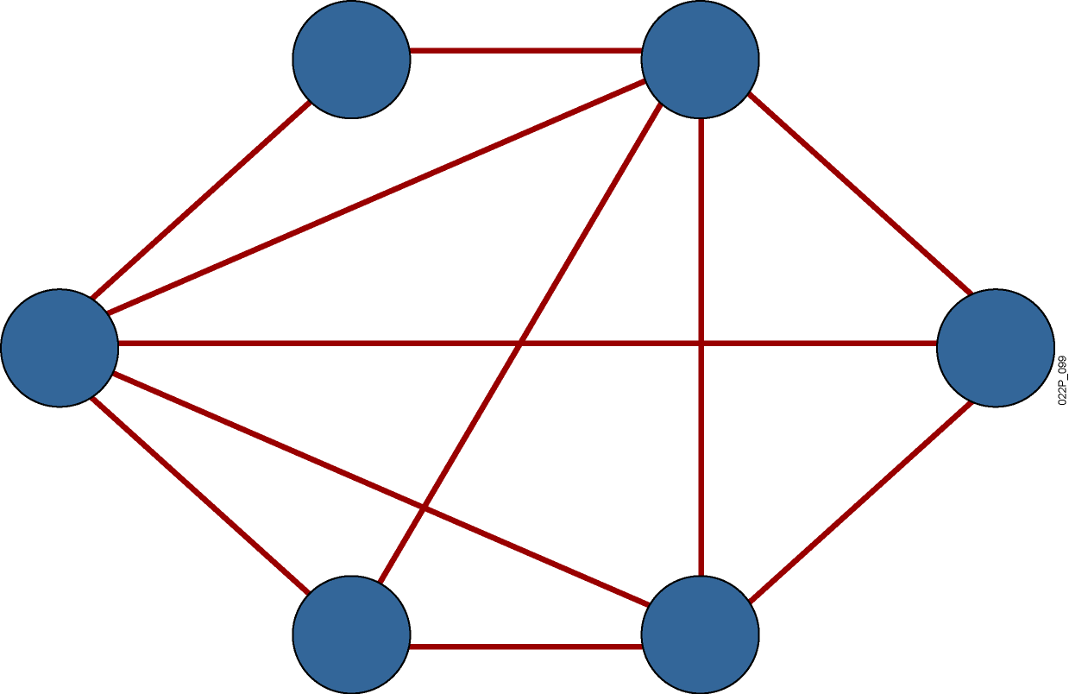
Partial-Mesh Topology
Trade-off between fault tolerance and cost
Notes:
Lesson Aim
<Enter lesson aim here.>

Slide 28
Securing the network

Slide 29
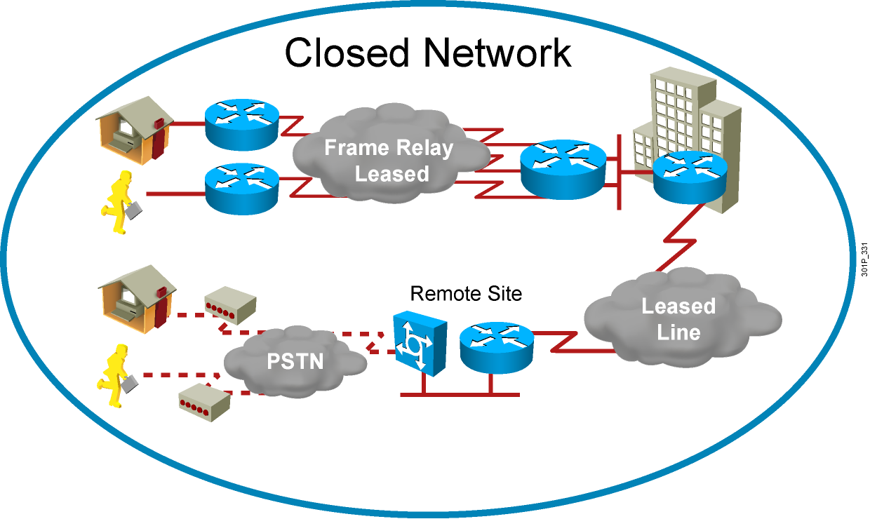
Closed Networks
Attacks from inside the network remain a threat.

Slide 30
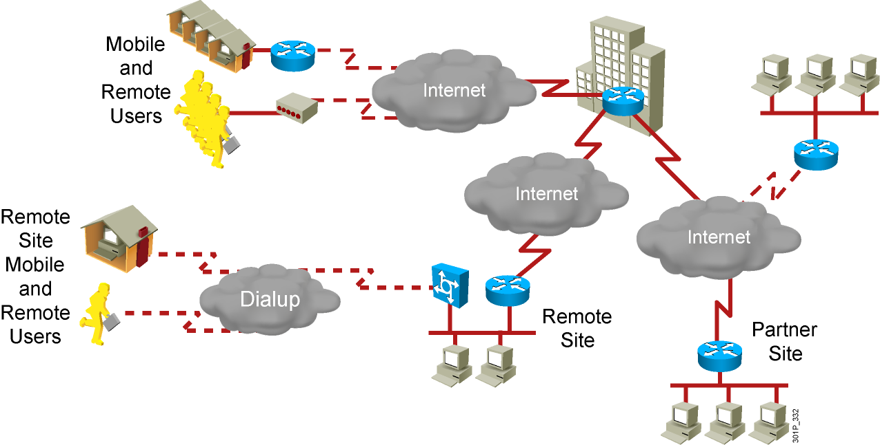
Open Networks

Slide 31
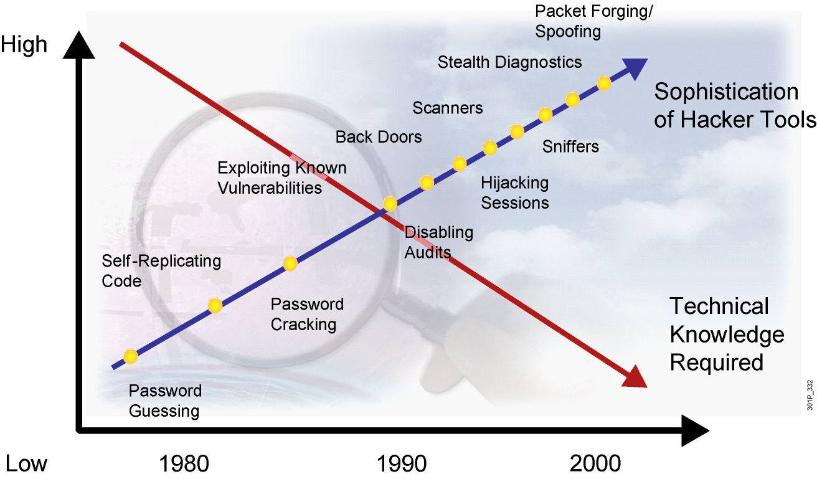
Threat Capabilities— More Dangerous and Easier to Use

Slide 32
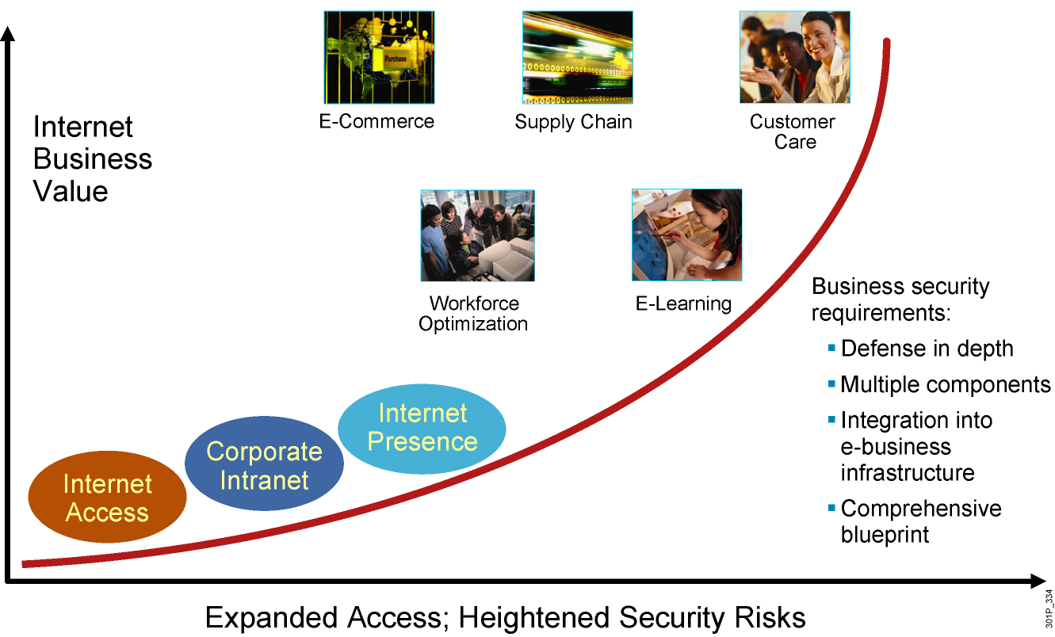
E-Business Challenge

Slide 33
Adversaries, Motivations, and Classes of Attack
Adversaries |  | Motivations |  | Classes of Attack
Nation-states Terrorists Criminals Hackers Crackers Competitors “Script kiddies” Disgruntled employees Government |  | Intelligence Theft DoS Embarrassiment Challenge |  | Passive Active Outside Inside Distributed

Slide 34
Common Threats
Physical installations
Hardware threats
Environmental threats
Electrical threats
Maintenance threats
Reconnaissance attacks—Learning information about a target network by using readily available information and applications
Access attacks—Attacks on networks or systems for these reasons:
Retrieve data
Gain access
Escalate their access privileges
Password attacks—Tools used by hackers to compromise passwords

Slide 35
Password Attack Threat Mitigation
Here are password attack threat-mitigation techniques:
Do not allow users to use the same password on multiple systems.
Disable accounts after a certain number of unsuccessful login attempts.
Do not use cleartext passwords.
Use “strong” passwords; for example, “mY8!Rthd8y” rather than “mybirthday.”

Slide 36
Connection to the Internet

Slide 37
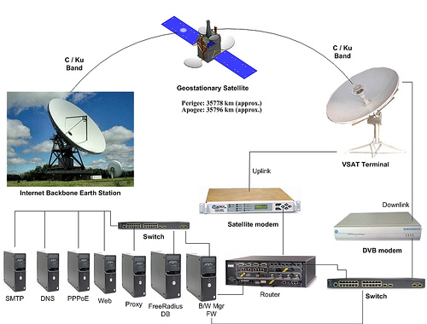
- DSL - Cable TV - FTTH - Leased Lined - 3G - Vệ tinh
Connection to the Internet

